Slide 1


Customers
Use this screen like this for a Sign-in for the both parts.
LOG IN >

Slide 2
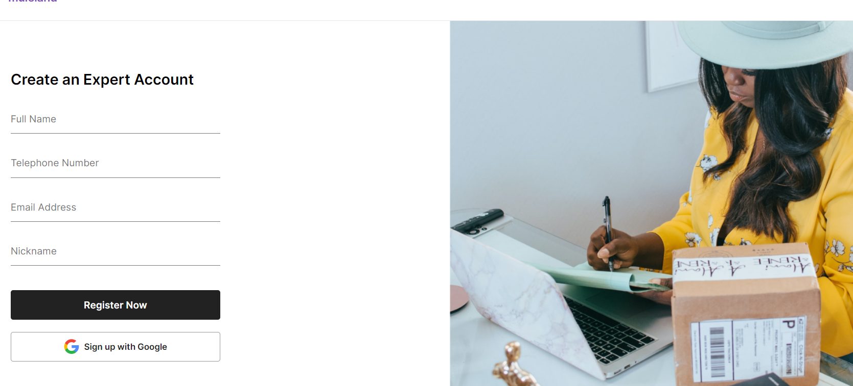

For Sign-in (both Customers and Freelancers)
« Create a Customer Account » for Customers Sign-up
We use the same Sign-up screen for buttons « Customers » and For the « Experts ».
The difference is for Experts, they will be directed after sign-up to take the Quizz While on other side, the Customers after the Sign-up, they will be directed to the profiles of Freelancers

